Slide 1

Tic-Tac-Toe Solver with Minimax and Memorization Optimization

Slide 2
About us
The provided code is a Tic-Tac-Toe game where a human player competes against an AI.
The code uses the Minimax algorithm to precompute the best move for each game state and store it for quick retrieval during gameplay.
I'll explain each part of the code in detail :

Slide 3
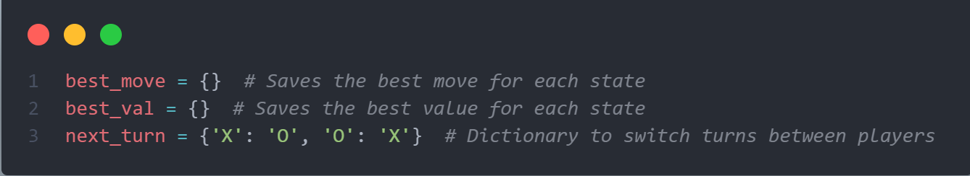
Constants and Dictionaries
best_move: A dictionary to store the best move for each game state.
best_val: A dictionary to store the best value (val) for each game state.
next_turn: A dictionary to determine the player who plays after the current player ('X' or 'O').

Slide 4
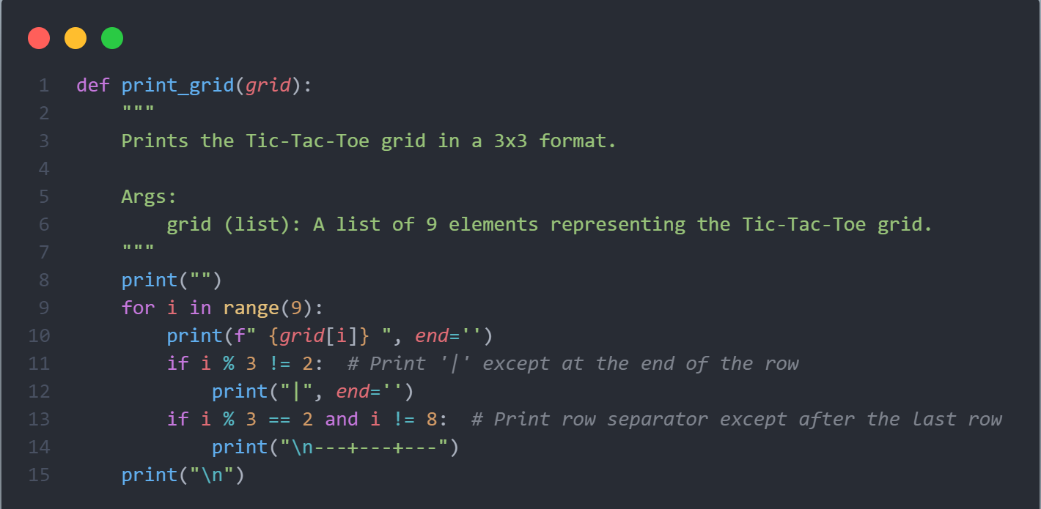
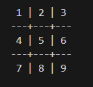
Function to Print the Grid
This function prints the current game grid in a formatted manner.

Slide 5
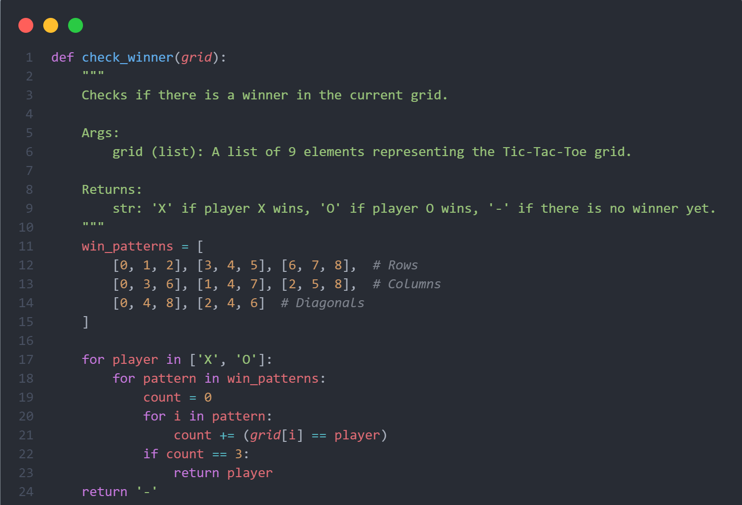
Function to Check the Winner
This function checks if there is a winner in the game based on possible winning patterns (rows, columns, diagonals).

Slide 6
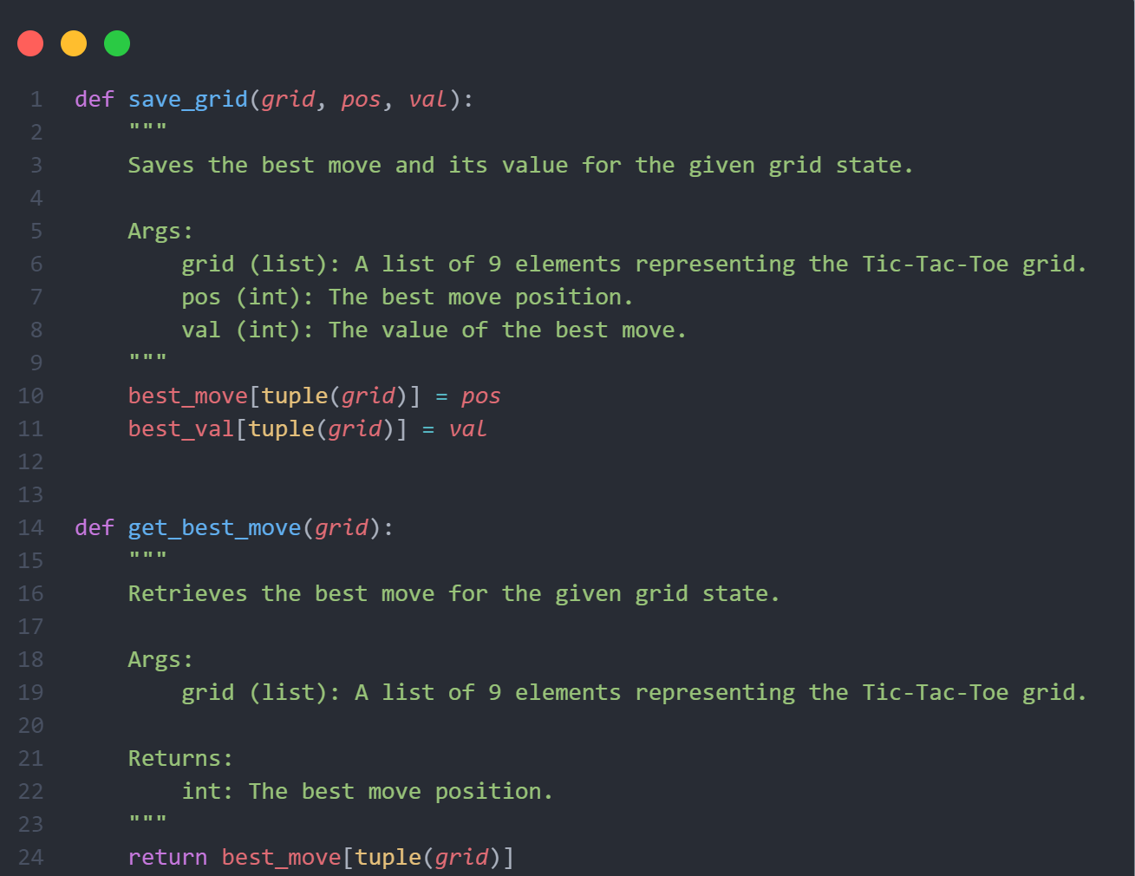
Functions to Store and Retrieve Best Moves and Values
save_grid: Stores the best move and value for a given game state.
get_best_move: Retrieves the best move for a given game state.

Slide 7
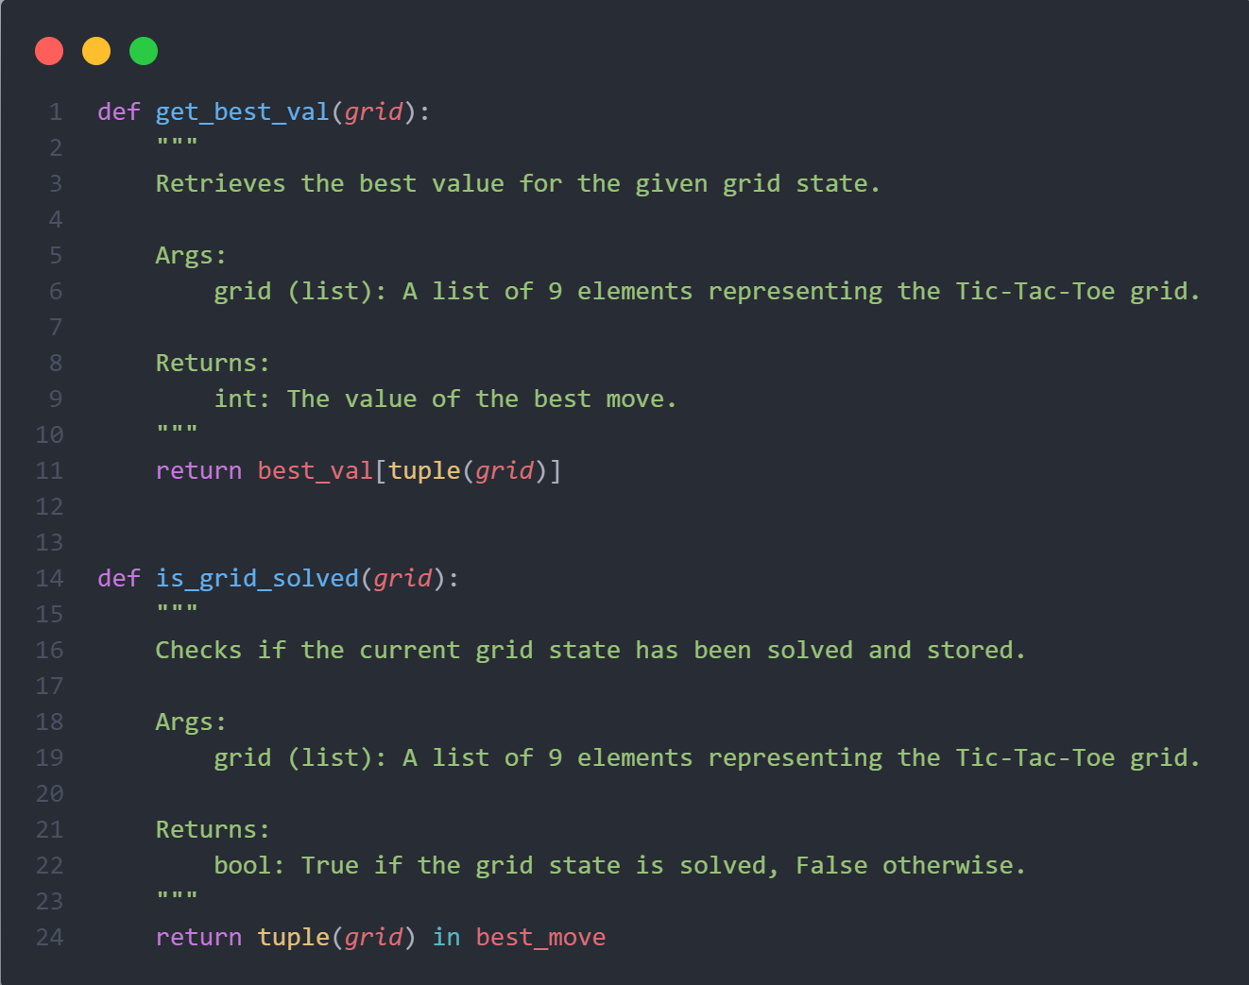
Functions to Store and Retrieve Best Moves and Values
get_best_val: Retrieves the best value for a given game state.
is_grid_solved: Checks if the game state has been precomputed.

Slide 8
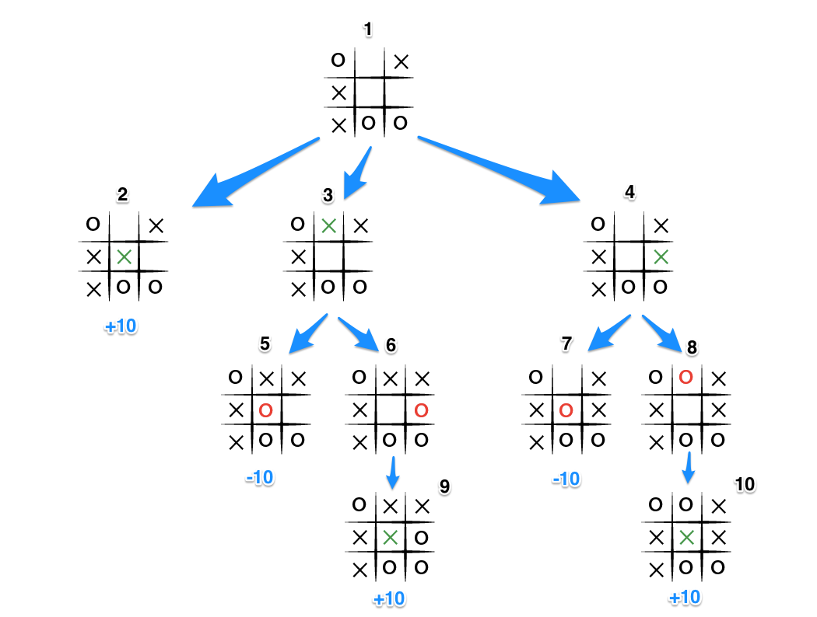
Minimax algorithm
Initial State (State 1): X's turn.
State Generation: X generates states 2, 3, and 4.
State 2: End state with a score of +10.
State 3: Generates states 5 and 6.
State 5: End state with a score of -10.
State 6: End state with a score of +10.
O's turn: Minimum score of -10.
State 4: Generates states 7 and 8.
State 7: End state with a score of -10.
State 8: End state with a score of +10.
O's turn: Minimum score of -10.
Back to State 1: Scores are +10
(state 2), -10 (state 3), -10 (state 4).
X Maximizes: Chooses state 2 with score +10.

Slide 9
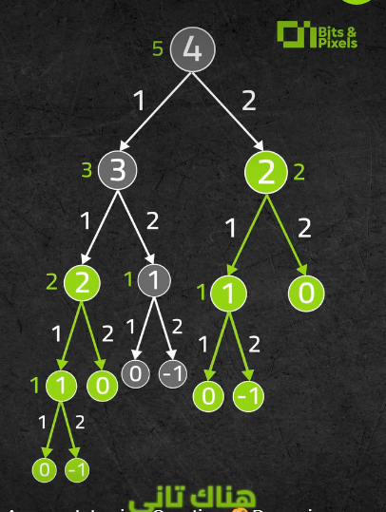
DP Memoization
State Storage: When evaluating a game state, we save its result in a dictionary. The key is a representation of the game state (e.g., a string or tuple), and the value is the computed Minimax score for that state.
Avoid Redundant Computation:
Before calculating the Minimax score for a state, we check if it’s already in the dictionary.
If the state is in the dictionary, we use the stored result instead of recalculating it.
If the state is not in the dictionary, we perform the Minimax calculation and then store the result in the dictionary.

Slide 10
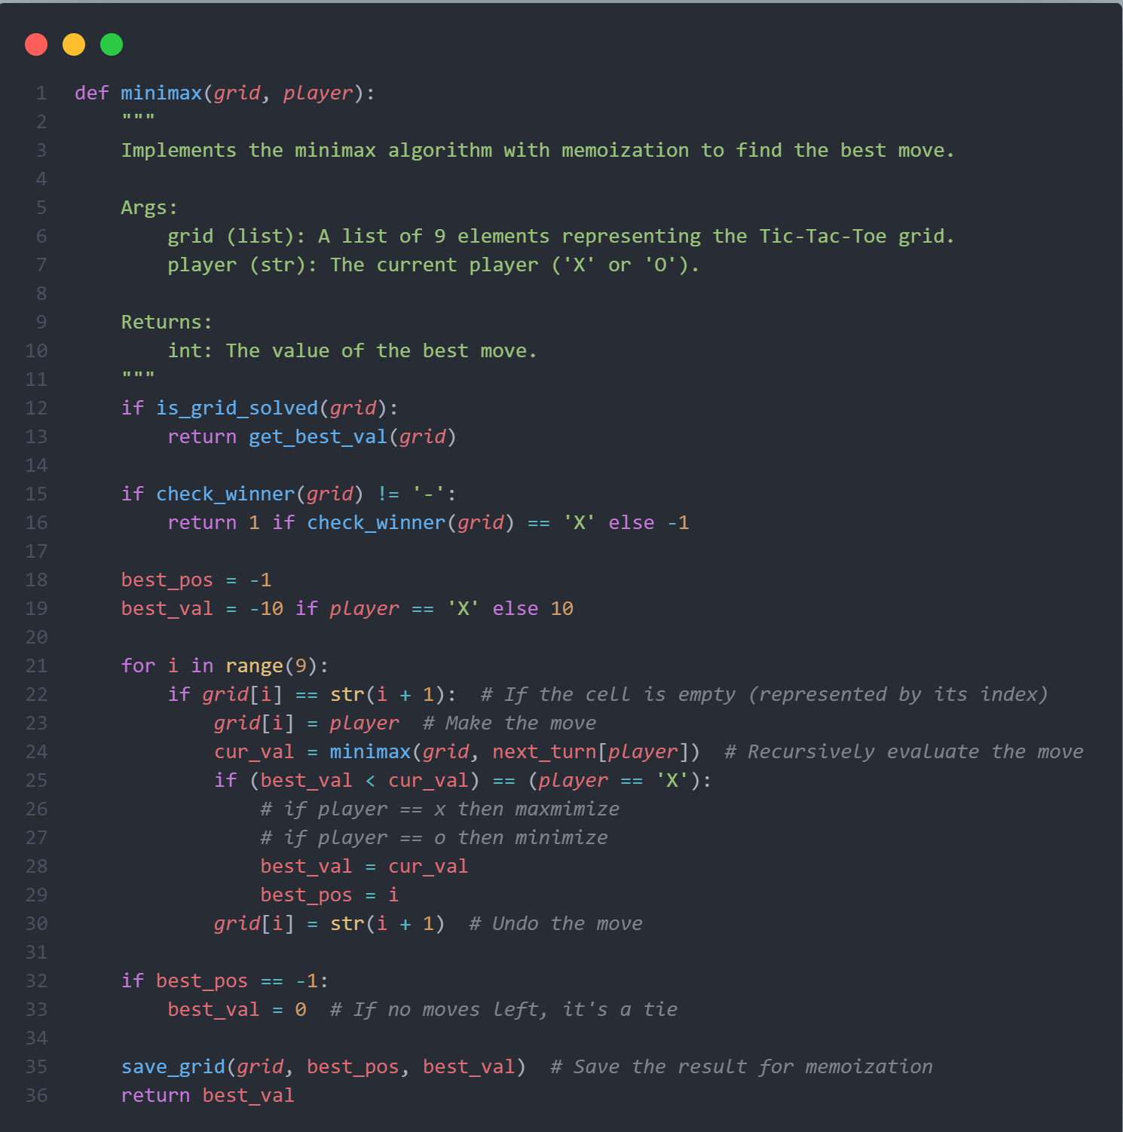
Minimax Function
This function implements the Minimax algorithm to determine the best move for each player (human and AI), storing the results for quick retrieval.

Slide 11
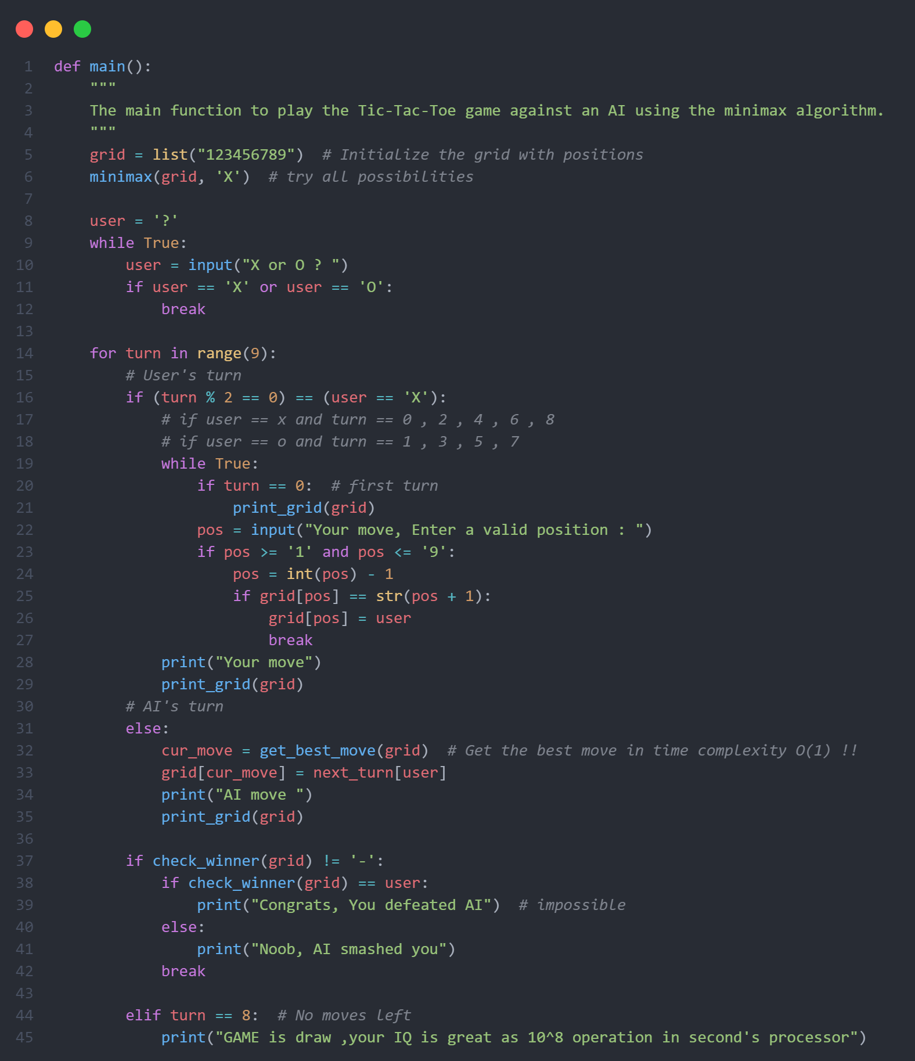
main Function
This function is the main entry point of the program.
It prompts the user to choose whether they want to play as 'X' or 'O'.
It initializes the game grid and alternates turns between the human player and the AI until the game ends.
It checks for a winner after each move and displays the final result.

Slide 12
Summary
To make the game unbeatable, it was necessary to create an algorithm that could calculate all the possible moves available for the computer player and use some metric to determine the best possible move. After extensive research it became clear that the Minimax algorithm was right for the job.
The code represents a Tic-Tac-Toe game where the player competes against an AI.
It uses the Minimax algorithm to precompute and store the best moves for each game state, allowing efficient gameplay.

Slide 13

Team Members
السيد عبدالمنجي السيد عطيه سالم
حازم مجدي محمد حسنين العقباوي
حسن فتحي ابراهيم ابو سريه
حمزه مسعد محمد عبدالفتاح محمد
خالد عبدالوهاب عبدالوهاب احمد الالفي
محمد مصطفي محمد الامام
مصطفي حماده محمد علي عبدالقدوس

Slide 14
Thank you

